Slide 1
Organizational Behavior
Topic: Group features and formation
Dr. C. Vijaya Banu
Associate Professor , School of Management
SASTRA Deemed University, Thanjavur – 613 401
vijayabanu@mba.sastra.edu

Slide 2

Foundations of group Behavior

Slide 3
Group
A collection of people who interact with one another, accept rights and obligations as a members and who share a common identity. e.g., Presentation group
Stephen P. Robins: “two or more individuals, interacting and interdependent, who have come together to achieve particular objectives.”
G. C. Homans: “any number of people who share goals, often communicate with each other over a period of time, and are few enough so that each individual may communicate with all the others, person-to-person.” In the modern days of IT, people need not physically come together, but they communicate and interact with each other. i.e., virtually coming together.
➢ They strive for a common goal, which becomes a bondage.
➢The members of the groups share their skills and other resources and achieve their goals through the integrated effort.
➢Thus, we can say that the group is a ‘combination of two or more people with a purpose of achieving their common and shared goals through their integrated effort.

Slide 4
Features/Characteristics of a Group
1. Combination of two or more individuals.
2. Individuals are motivated to come closer physically, and/ or virtually for interaction.
3. They come closer to achieve their common and shared goals.
4. Group members achieve their common goals through integrated efforts.
5. Perceive the group as a unified unit and stable structure.
6. Members contribute different inputs (skills, knowledge, effort, etc.) towards achievement of group goals.
7. Reach agreement and disagreement through various forms of interaction.

Slide 5
Need/Reasons for joining of Group

Slide 6
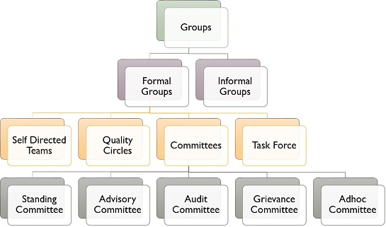
Types

Slide 7
Types of groups
Different people join groups with various purposes or due to the forces of different factors. – Hence different types of groups are formed.
Formal Group: when two or more individuals join together as a group due to the official job structure and relationship in a organisation. ex: group of production manager, materials manager, quality control manager.
Informal Group: when two or more individuals join together as a group in order to satisfy their social needs but not due to official job structure and organisational requirements. These are formed out of the common interests, aptitudes, values, opinions, ideas and characteristics of the groups. Ex: Quality circles.
Command Group: a group of the superior and his/her subordinates. i.e., it is a group of individual employees and their manager to whom they report. Ex: finance managers and Asst. finance manager
Clique-a small close-knit group of people who do not readily allow others to join them.

Slide 8
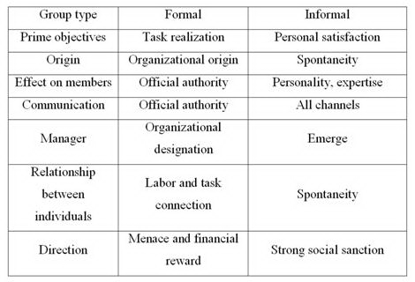
Difference

Slide 9
Types of groups
Task Group: people working together in order to accomplish a particular task.
Interested Group: Interest group, any association of individuals or organizations that attempts to influence public policy in favour of its shared concerns. An interest group or an advocacy group is a body which uses various forms of advocacy in order to influence public opinion and/or policy. Interest group may also refer to: Learned society. Special interest group, a group of individuals sharing specialist knowledge.
Friendship Groups: people with common characteristics like hard working, work avoiding, smart working, status seeking, family orientation, risk taking, etc.
Primary Groups: individuals with a feeling of comradeship, loyalty and a common sense of values form into a group. Ex: group of family members such as father, mother, brother and sister.
Coalitions: individuals from different groups form into an ad hoc group in order to achieve a specific task or goals. Here the individuals have dual membership, i.e., one in the original group and another in the coalition. - the coalition gets dissolved once the goal is attained

Slide 11
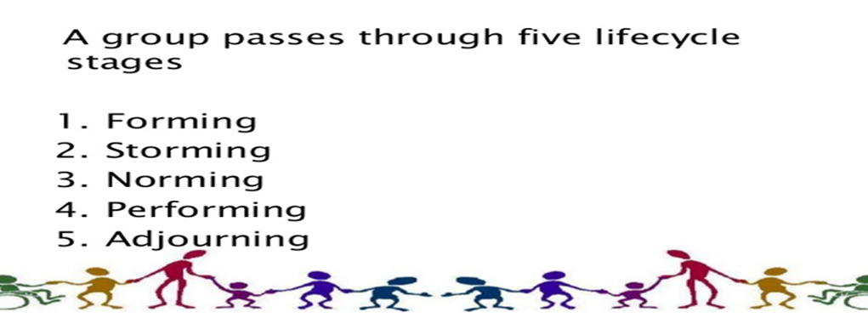
Tuckman Theory of group formation

Slide 12
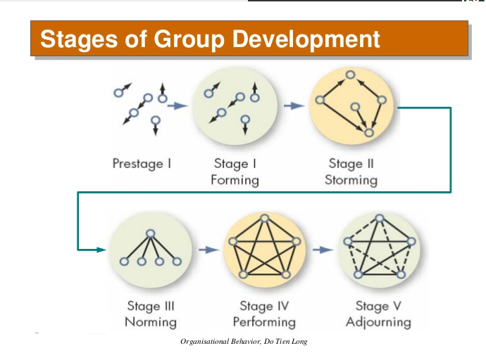

Slide 13
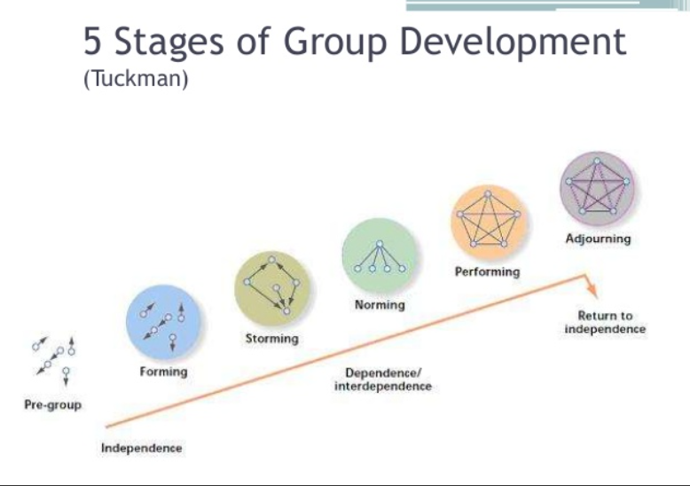

Slide 17
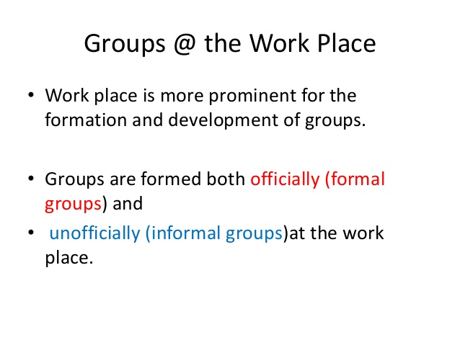

Slide 18
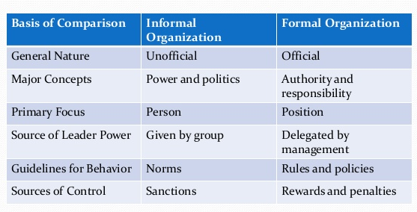
Formal and informal organisations

Slide 19
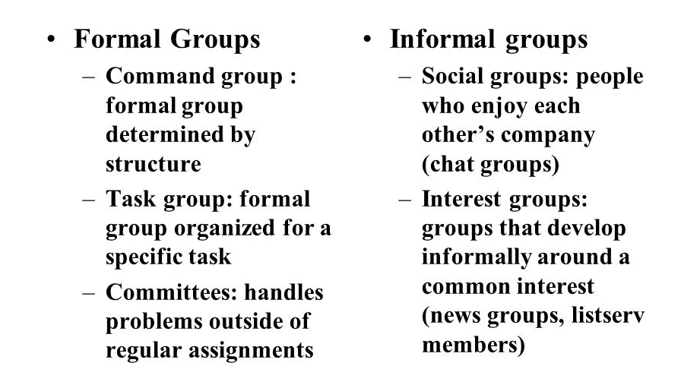
Types of group

Slide 20
Contributions of Formal Groups
Contributions to Organizations
1. Accomplish complex, independent tasks that are beyond the capabilities of individuals.
2. Create new ideas
3. Coordinate interdepartmental efforts.
4. Solve complex problems requiring varied information and perspectives.
5. Implement action plans.
6. Socialise and train newcomers.
Contributions to Individuals
1. Satisfy needs for affiliation.
2. Confirm identity and enhance self-esteem.
3. Test and share perceptions of social reality.
4. Reduce feelings of insecurity and powerlessness.
5. Provide a mechanism for solving personal and interpersonal problems.

Slide 21
Contributions of Informal Groups
Contributions to Individuals
1. Satisfaction of social and affiliation needs.
2. Satisfaction of needs for security and support.
3. Enhanced status for members if the group is perceived by others as prestigious.
4. Enhanced feelings of self-esteem if a member is valued by other group members.
5. Feeling more competent by sharing the power of the group to influence and achieve.
Contributions to Organisations
1. Solidify common social values and expectations congruent with organisational culture.
2. Provide and enforce guidelines for appropriate behaviour.
3. Provide social satisfaction unlikely for anonymous individual workers to experience.
4. Provide a sense of identity that often includes a certain degree of status.
5. Enhance members’ access to information.
6. Help integrate new employees into the formal expectations of the organization.

Slide 22
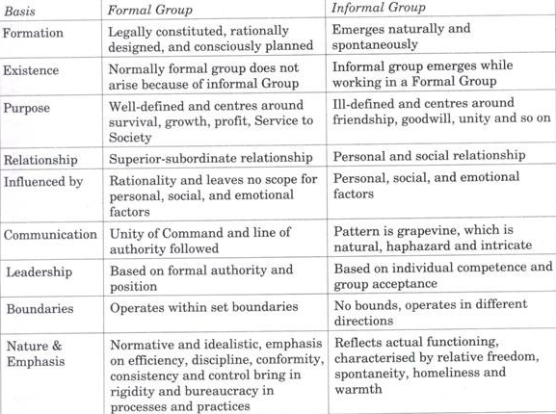
Differences

Slide 23
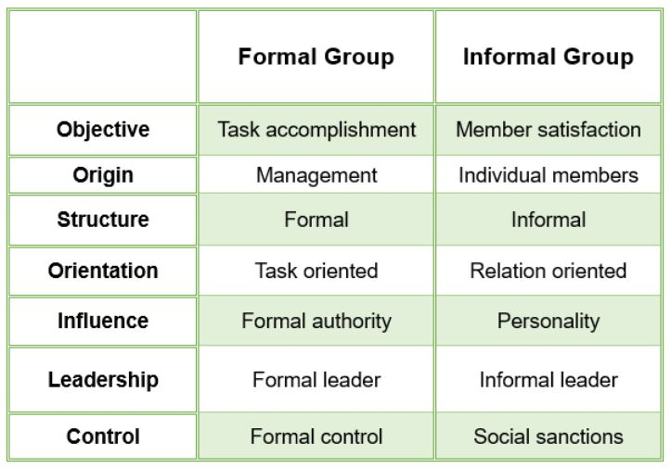
Difference

Slide 26
Organisational Behavior
Topic: Group Behavior & properties
Dr. C. Vijaya Banu
Professor , School of Management
SASTRA Deemed University, Thanjavur – 613 401
vijayabanu@mba.sastra.edu

Slide 27
Group Properties
Role(s)
Norms
Status
Size
Cohesiveness

Slide 28
Group Properties - Roles
Role(s)
A set of expected behavior patterns attributed to someone occupying a given position in a social unit.
Role Identity
Certain attitudes and behaviors consistent with a role.
Role Perception
An individual’s view of how he or she is supposed to act in a given situation.

Slide 29
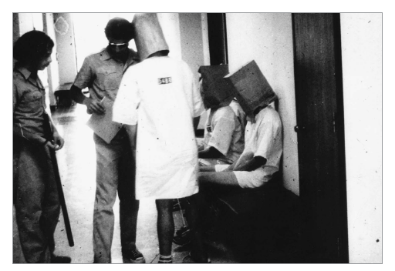
Group Properties - Roles (cont’d)
Role Expectations
How others believe a person should act in a given situation.
Psychological Contract
An unwritten agreement that sets out what management expects from the employee and vice versa.
Role Conflict
A situation in which an individual is confronted by divergent role expectations.

Slide 30
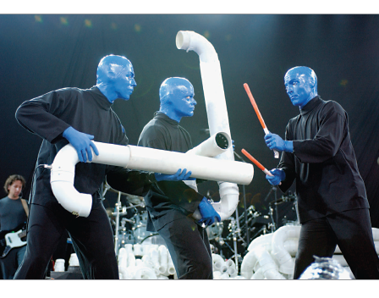
Group Properties - Norms
Norms
Acceptable standards of behavior within a group that are shared by the group’s members.
Classes of Norms:
Performance norms
Appearance norms
Social arrangement norms
Allocation of resources norms

Slide 31
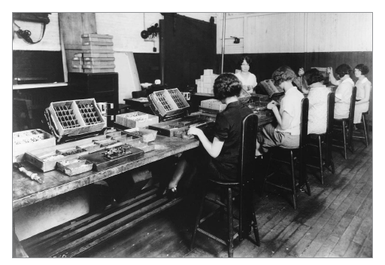
Group Norms & The Hawthorne Studies
A series of studies undertaken by Elton Mayo at Western Electric Company’s Hawthorne Works in Chicago between 1924 and 1932.
Research Conclusions:
Worker behavior and sentiments were closely related.
Group influences (norms) were significant in affecting individual behavior.
Group standards (norms) were highly effective in establishing individual worker output.
Money was less a factor in determining worker output than were group standards, sentiments, and security.

Slide 32
Group Properties - Norms (cont’d)
Conformity
Adjusting one’s behavior to align with the norms of the group.
Reference Groups
Important groups to which individuals belong or hope to belong and with whose norms individuals are likely to conform.

Slide 33
Group Properties - Norms (cont’d)
Deviant Workplace Behavior
Antisocial actions by organizational members that intentionally violate established norms and result in negative consequences for the organization, its members, or both.
Group norms can influence the
presence of deviant behavior.

Slide 34
Typology of Deviant Workplace Behavior
Category Examples Production Leaving early Intentionally working slowly Wasting resources
Property Sabotage Lying about hours worked Stealing from the organization
Political Showing favoritism Gossiping and spreading rumors Blaming coworkers
Personal Aggression Sexual harassment Verbal abuse Stealing from coworkers
Source: Adapted from S.L. Robinson, and R.J. Bennett. “A Typology of Deviant Workplace Behaviors: A Multidimensional Scaling Study,” Academy of Management Journal, April 1995, p. 565.

Slide 35
Group Properties - Status
Status: A socially defined position or rank given to groups or group members by others.
Power over Others
Norms & Interaction
Ability to Contribute
Group Member Status
Personal Characteristics
Other things influencing or influenced by status
Status Inequity
National Culture

Slide 36
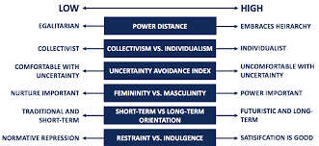
Cultural differences

Slide 37
Group Properties - Size
Social Loafing The tendency for individuals to expend less effort when working collectively than when working individually.
Performance
Other conclusions:
Odd number groups do better than even.
Groups of 5 to 7 perform better overall than larger or smaller groups.
Expected
Actual (due to loafing)
Group Size

Slide 38
Group Properties - Cohesiveness
Cohesiveness
Degree to which group members are attracted to each other and are motivated to stay in the group.
Increasing group cohesiveness:
Make the group smaller.
Encourage agreement with group goals.
Increase time members spend together.
Increase group status and admission difficultly.
Stimulate competition with other groups.
Give rewards to the group, not individuals.
Physically isolate the group.

Slide 39
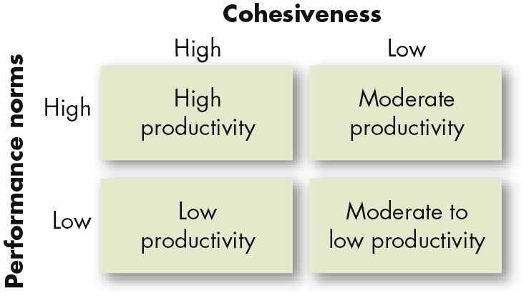
Relationship Between Group Cohesiveness, Performance Norms, and Productivity

Slide 40
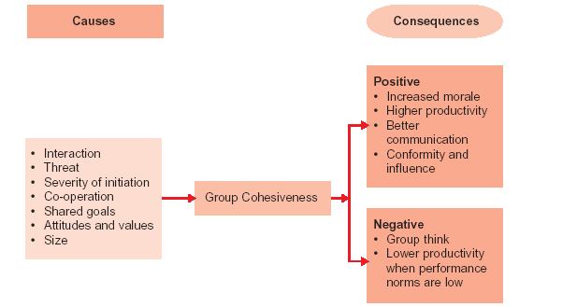
Group Cohesiveness – Causes and Consequences

Slide 44
Need/Reasons for Formation of Group
Formation of groups is necessary as humans are basically social beings. Most people prefer to live and work in groups.
Some reasons are:
1. Security
2. Empowerment through sharing of resources: exchange of skills, knowledge, talents, values, etc.
3. Becoming a leader: people with leadership skills can become leaders to form the groups, lead the groups
4. Synergy: outcome of the group effort is greater than the sum of the individual

Slide 47
